Slide 1
ARP
RARP
ICMP
IGMP

Slide 2
ADDRESS MAPPING
The delivery of a packet to a host or a router requires two levels of addressing: logical and physical. We need to be able to map a logical address to its corresponding
physical address and vice versa. This can be done by using either static or dynamic mapping.

Slide 3

Figure 1: ARP operation

Slide 4

Figure 2: Four cases using ARP

Slide 5

Note
An ARP request is broadcast;
an ARP reply is unicast.
21.<number>

Slide 6
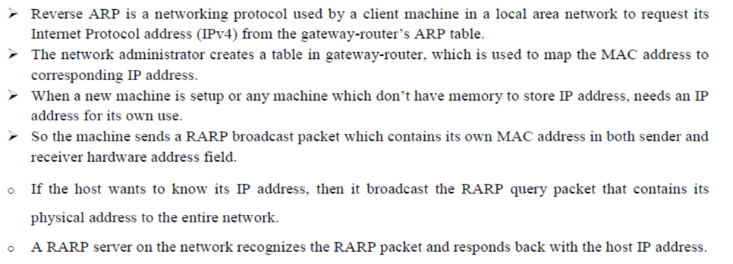
Reverse Address Resolution Protocol (RARP)

Slide 7
ICMP
The IP protocol has no error-reporting or error-correcting mechanism. The IP protocol also lacks a mechanism for host and management queries. The Internet Control Message Protocol (ICMP) has been designed to compensate for the above two deficiencies. It is a companion to the IP protocol.
Topics discussed in this section:
Types of Messages
Message Format
Error Reporting and Query
Debugging Tools

Slide 8

Figure 3: General format of ICMP messages

Slide 9
Note
ICMP always reports error messages to the original source.

Slide 10
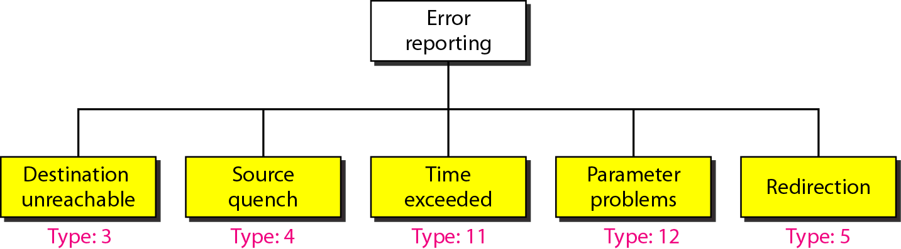
Figure 4: Error-reporting messages

Slide 11
Note
Important points about ICMP error messages:
❏ No ICMP error message will be generated in
response to a datagram carrying an ICMP error
message.
❏ No ICMP error message will be generated for a
fragmented datagram that is not the first fragment.
❏ No ICMP error message will be generated for a
datagram having a multicast address.
❏ No ICMP error message will be generated for a
datagram having a special address such as
127.0.0.0 or 0.0.0.0.

Slide 12
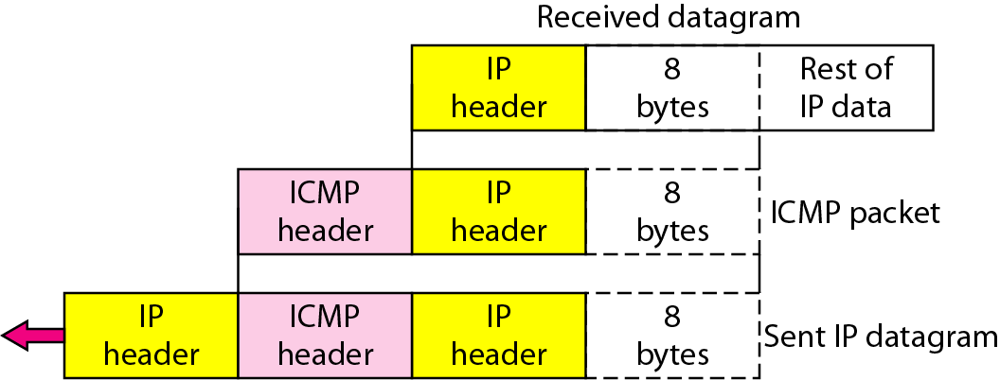
Figure 4: Contents of data field for the error messages

Slide 13
IGMP
The IP protocol can be involved in two types of communication: unicasting and multicasting. The Internet Group Management Protocol (IGMP) is one of the necessary, but not sufficient, protocols that is involved in multicasting. IGMP is a companion to the IP protocol.

Slide 14
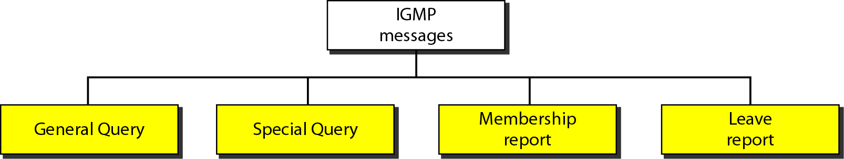
Figure 5: IGMP message types

Slide 15
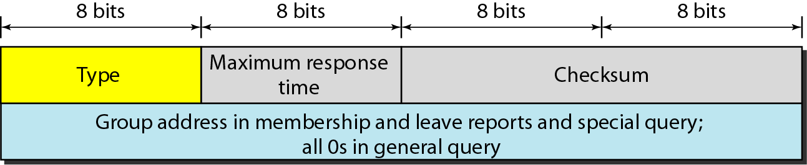
Figure 21.17 IGMP message format

Slide 16
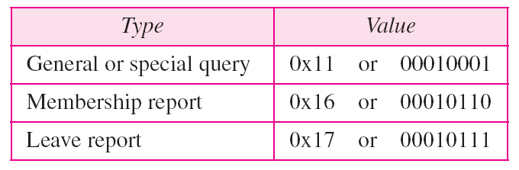
Table 6: IGMP type field

Slide 17
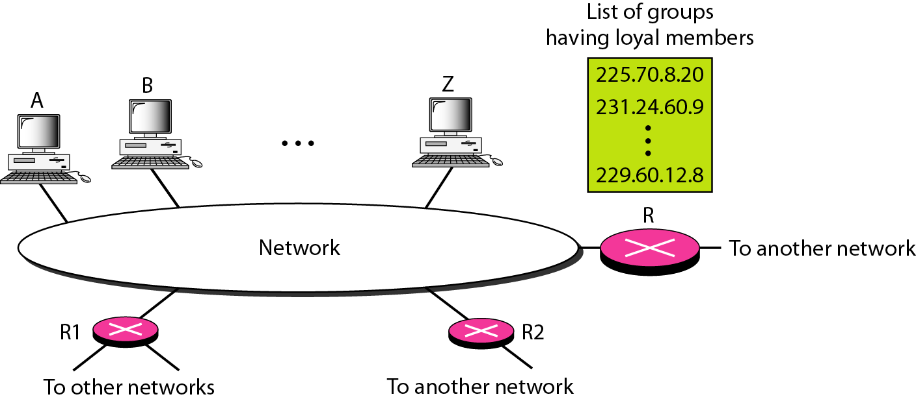
Figure 7: IGMP operation

Slide 18
Note
In IGMP, a membership report is sent twice, one after the other.

Slide 19
Note
The general query message does not define a particular group.

